Slide 1
High Technology
By: Vivek Limbavali
MGMT 6160: Data Analytics
December 1, 2015

Slide 2
Subsector: Information Tech. (IT)
create, process, store, secure and exchange all forms of electronic data.
first appeared in a 1958 article published in the Harvard Business Review "the new technology does not yet have a single established name. We shall call it information technology (IT)."

Slide 3
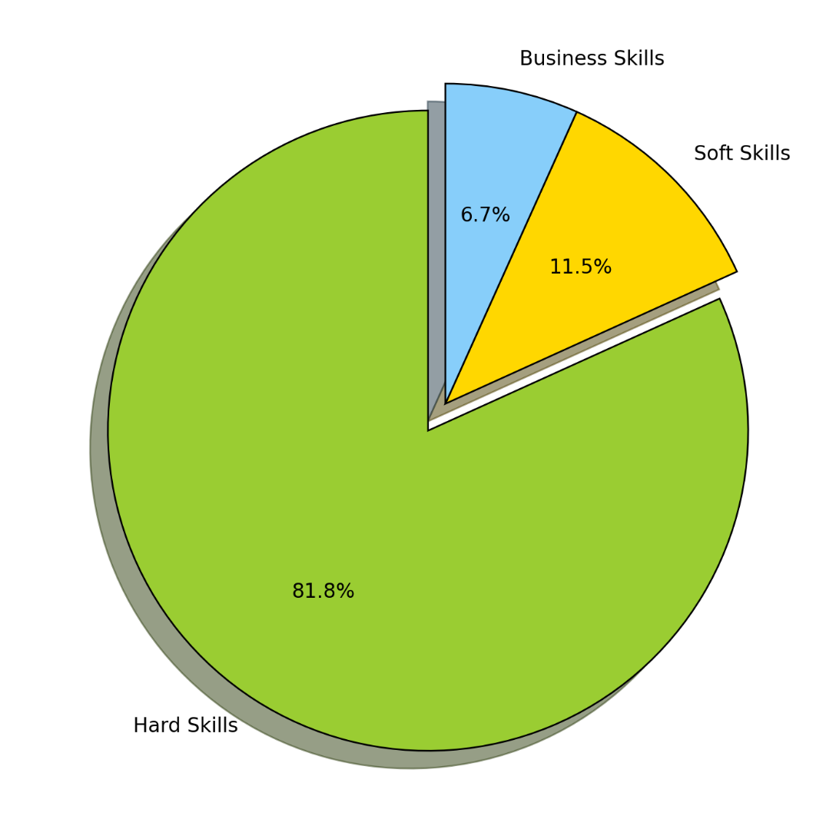
Visual 1: Skillset Categories

Slide 4
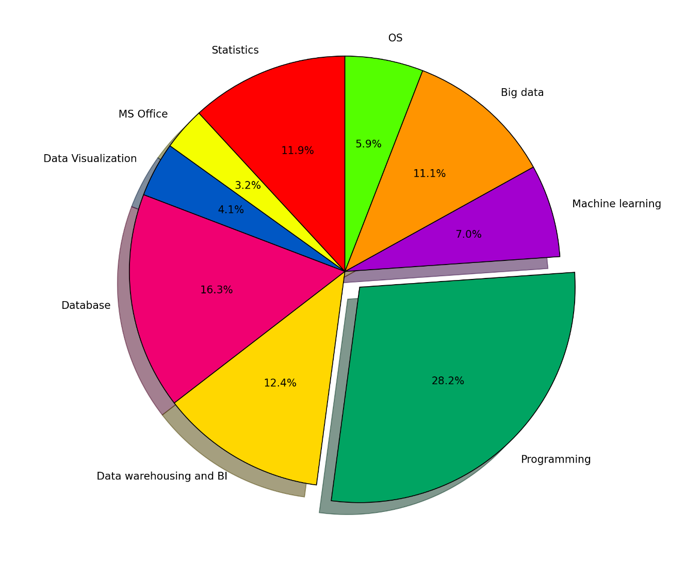
Visual 2 : Hard Skillsets

Slide 5
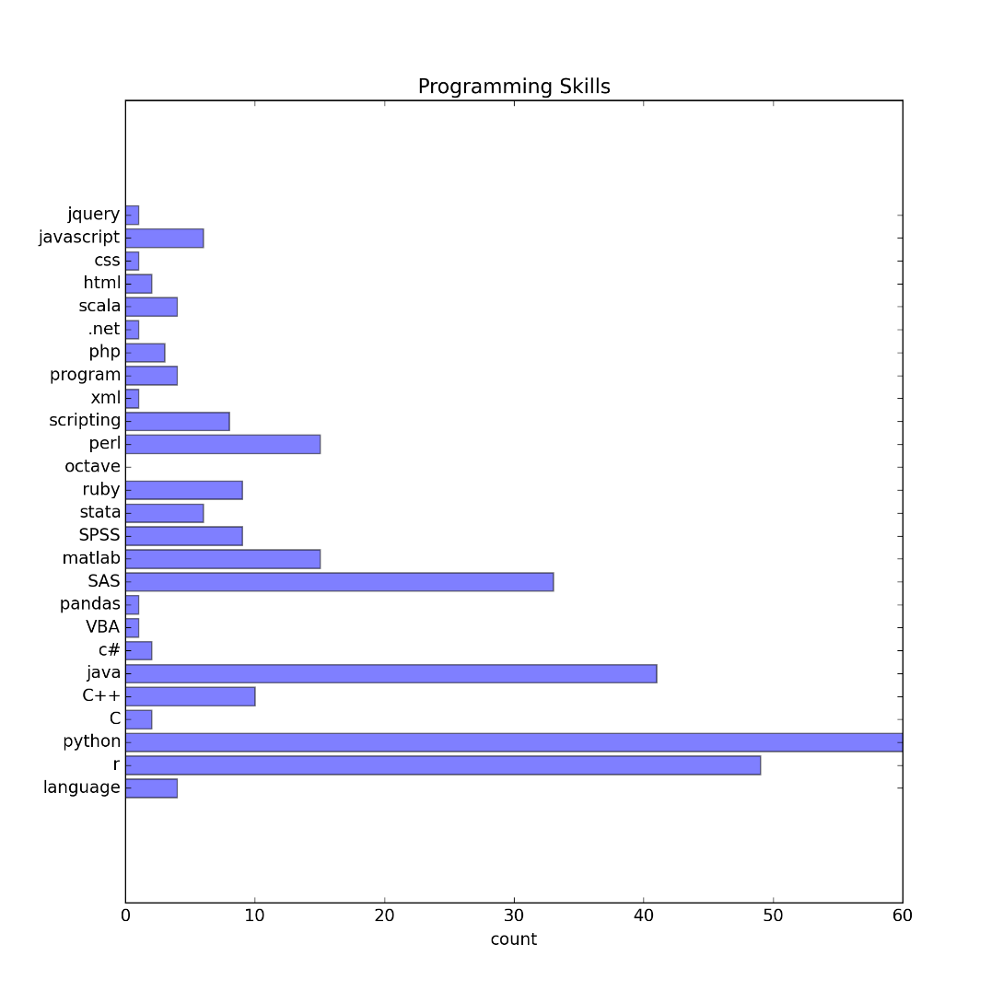
Visual 3 : Programming Skill

Slide 6
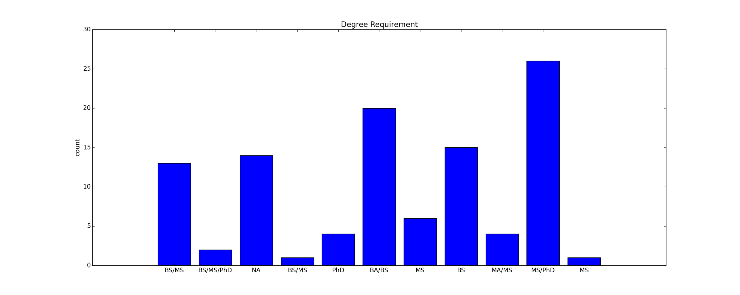
Visual 4 : Job Count Vs Degree

